Slide 1
Multithreading in java
Multithreading in java is a process of executing multiple threads simultaneously.
Thread is basically a lightweight sub-process, a smallest unit of processing. Multiprocessing and multithreading, both are used to achieve multitasking.
But we use multithreading than multiprocessing because threads share a common memory area. They don't allocate separate memory area so saves memory, and context-switching between the threads takes less time than process.
Java Multithreading is mostly used in games, animation etc.

Slide 2
Advantages of Java Multithreading
1) It doesn't block the user because threads are independent and you can perform multiple operations at same time.
2) You can perform many operations together so it saves time.
3) Threads are independent so it doesn't affect other threads if exception occur in a single thread.

Slide 3
Multitasking
Multitasking is a process of executing multiple tasks simultaneously. We use multitasking to utilize the CPU. Multitasking can be achieved by two ways:
Process-based Multitasking(Multiprocessing)
Thread-based Multitasking(Multithreading)
1) Process-based Multitasking (Multiprocessing)
Each process have its own address in memory i.e. each process allocates separate memory area.
Process is heavyweight.
Cost of communication between the process is high.
Switching from one process to another require some time for saving and loading registers, memory maps, updating lists etc.
2) Thread-based Multitasking (Multithreading)
Threads share the same address space.
Thread is lightweight.
Cost of communication between the thread is low.
Note : Atleast one process is required for each thread.

Slide 4
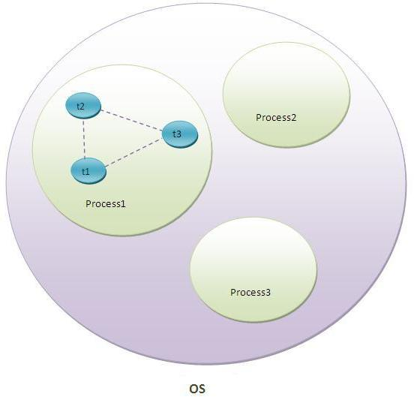
What is Thread in java
A thread is a lightweight sub process, a smallest unit of processing. It is a separate path of execution.
Threads are independent, if there occurs exception in one thread, it doesn't affect other threads. It shares a common memory area.

Slide 5
As shown in the above figure, thread is executed inside the process. There is context-switching between the threads. There can be multiple processes inside the OS and one process can have multiple threads.
Note: At a time one thread is executed.

Slide 6
Life cycle of a Thread (Thread States)
A thread can be in one of the five states. According to sun, there is only 4 states in thread life cycle in java new, runnable, non-runnable and terminated. There is no running state.
But for better understanding the threads, we are explaining it in the 5 states.
The life cycle of the thread in java is controlled by JVM. The java thread states are as follows:
New
Runnable
Running
Non-Runnable (Blocked)
Terminated

Slide 7
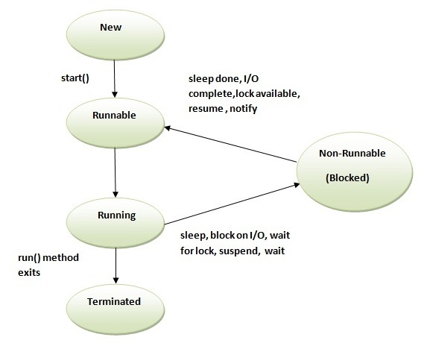

Slide 8
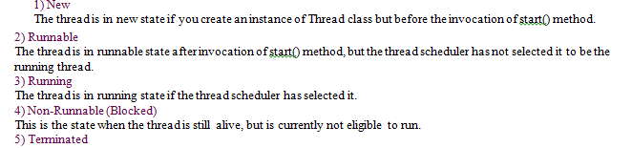

Slide 9
How to create thread
There are two ways to create a thread:
By extending Thread class
2. By implementing Runnable interface.

Slide 10
Thread class:
Thread class provide constructors and methods to create and perform operations on a thread.Thread class extends Object class and implements Runnable interface.
Commonly used Constructors of Thread class:
Thread() Thread(String name) Thread(Runnable r) Thread(Runnable r,String name)

Slide 11
Commonly used methods of Thread class:
public void run(): is used to perform action for a thread.
public void start(): starts the execution of the thread.JVM calls the run() method on the thread.
public void sleep(long miliseconds): Causes the currently executing thread to sleep (temporarily cease execution) for the specified number of milliseconds.
public void join(): waits for a thread to die.
public void join(long miliseconds): waits for a thread to die for the specified miliseconds.
public int getPriority(): returns the priority of the thread.
public int setPriority(int priority): changes the priority of the thread.
public String getName(): returns the name of the thread.
public void setName(String name): changes the name of the thread.
public Thread currentThread(): returns the reference of currently executing thread.

Slide 12
Runnable interface:
The Runnable interface should be implemented by any class whose instances are intended to be executed by a thread. Runnable interface have only one method named run().
public void run(): is used to perform action for a thread.

Slide 13
Starting a thread:
start() method of Thread class is used to start a newly created thread. It performs following tasks:
A new thread starts(with new callstack).
The thread moves from New state to the Runnable state.
When the thread gets a chance to execute, its target run() method will run.

Slide 14
Note:
If you are not extending the Thread class, your class object would not be treated as a thread object. So you need to explicitly create Thread class object. We are passing the object of your class that implements Runnable so that your class run() method may execute.

Slide 15
Java Thread Example by extending Thread class
class Multi extends Thread{
public void run(){
System.out.println("thread is running...");
}
public static void main(String args[]){
Multi t1=new Multi();
t1.start();
}
}

Slide 16
Java Thread Example by implementing Runnable interface
class Multi3 implements Runnable{
public void run(){
System.out.println("thread is running...");
}
public static void main(String args[]){
Multi3 m1=new Multi3();
Thread t1 =new Thread(m1);
t1.start();
}
}

Slide 17
Thread Scheduler in Java
Thread scheduler in java is the part of the JVM that decides which thread should run.
There is no guarantee that which runnable thread will be chosen to run by the thread scheduler.
Only one thread at a time can run in a single process.
The thread scheduler mainly uses preemptive or time slicing scheduling to schedule the threads.
What is the difference between preemptive scheduling and time slicing?
Under preemptive scheduling, the highest priority task executes until it enters the waiting or dead states or a higher priority task comes into existence. Under time slicing, a task executes for a predefined slice of time and then reenters the pool of ready tasks. The scheduler then determines which task should execute next, based on priority and other factors.

Slide 18
Sleep method in java
The sleep() method of Thread class is used to sleep a thread for the specified amount of time.
Syntax of sleep() method in java
The Thread class provides two methods for sleeping a thread:
public static void sleep(long miliseconds)throws InterruptedException
public static void sleep(long miliseconds, int nanos)throws InterruptedException
Note: As you know well that at a time only one thread is executed. If you sleep a thread for the specified time,the thread shedular picks up another thread and so on.

Slide 19
public static void sleep(long millis, int nanos) throws InterruptedException Parameters
The java.lang.Thread.sleep(long millis, int nanos) method causes the currently executing thread to sleep for the specified number of milliseconds plus the specified number of nanoseconds, subject to the precision and accuracy of system timers and schedulers. millis − This is the length of time to sleep in milliseconds.
nanos − This is 0-999999 additional nanoseconds to sleep.
Return Value
This method does not return any value.
Exception
IllegalArgumentException − if the value of millis is negative or the value of nanos is not in the range 0-999999.
InterruptedException − if any thread has interrupted the current thread. The interrupted status of the current thread is cleared when this exception is thrown.

Slide 20
Example of sleep
class TestSleepMethod1 extends Thread{
public void run(){
for(int i=1;i<5;i++){
try{Thread.sleep(500);}catch(InterruptedException e){System.out.println(e);}
System.out.println(i);
}
}
public static void main(String args[]){
TestSleepMethod1 t1=new TestSleepMethod1();
TestSleepMethod1 t2=new TestSleepMethod1();
t1.start();
t2.start();
}
}
Output:
1 1 2 2 3 3 4 4

Slide 21
Questions
Can we start a thread twice?
Ans No. After starting a thread, it can never be started again. If you does so, an IllegalThreadStateException is thrown. In such case, thread will run once but for second time, it will throw exception.
What if we call run() method directly instead start() method?
Each thread starts in a separate call stack.
Invoking the run() method from main thread, the run() method goes onto the current call stack rather than at the beginning of a new call stack.

Slide 22
class TestCallRun1 extends Thread{
public void run(){
System.out.println("running...");
}
public static void main(String args[]){
TestCallRun1 t1=new TestCallRun1();
t1.run();//fine, but does not start a separate call stack
}
}
Output:running...

Slide 23
class TestCallRun2 extends Thread{
public void run(){
for(int i=1;i<5;i++){
try{Thread.sleep(500);}catch(InterruptedException e){System.out.println(e);}
System.out.println(i);
}
}
public static void main(String args[]){
TestCallRun2 t1=new TestCallRun2();
TestCallRun2 t2=new TestCallRun2();
t1.run();
t2.run();
}
}
Output:1
2
3
4
5
1
2
3
4
5
As you can see in the above program that there is no context-switching because here t1 and t2 will be treated as normal object not thread object

Slide 24
Joining threads
Sometimes one thread needs to know when other thread is terminating. In java, isAlive() and join()are two different methods that are used to check whether a thread has finished its execution or not.
The isAlive() method returns true if the thread upon which it is called is still running otherwise it returns false.
Syntax: final boolean isAlive()
But, join() method is used more commonly than isAlive(). This method waits until the thread on which it is called terminates.
Syntax: final void join() throws InterruptedException
Using join() method, we tell our thread to wait until the specified thread completes its execution. There are overloaded versions of join() method, which allows us to specify time for which you want to wait for the specified thread to terminate.
Syntax: final void join(long milliseconds) throws InterruptedException
Note: As we know that the main thread must always be the last thread to finish its execution. Therefore, we can use Thread join() method to ensure that all the threads created by the program has been terminated before the execution of the main thread.

Slide 25
Example of isAlive method
public class MyThread extends Thread
{
public void run()
{
System.out.println("r1 ");
try {
Thread.sleep(500);
}
catch(InterruptedException ie) { }
System.out.println("r2 ");
}
public static void main(String[] args)
{
MyThread t1=new MyThread();
MyThread t2=new MyThread();
t1.start();
t2.start();
System.out.println(t1.isAlive());
System.out.println(t2.isAlive());
}
}
Output :
r1
true
true
r1
r2
r2

Slide 26
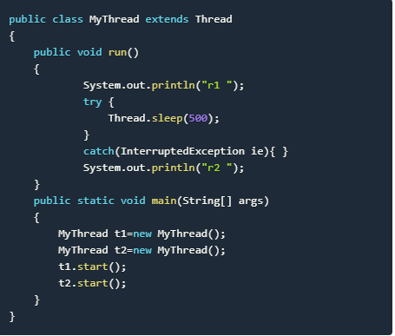
Output
In this above program two thread t1 and t2 are created. t1 starts first and after printing "r1" on console thread t1 goes to sleep for 500 ms. At the same time Thread t2 will start its process and print "r1" on console and then go into sleep for 500 ms. Thread t1 will wake up from sleep and print "r2" on console similarly thread t2 will wake up from sleep and print "r2" on console. So you will get output like r1 r1 r2 r2

Slide 27
Example of thread with join() method
public class MyThreadjoin extends Thread
{
public void run()
{
System.out.println("r1 ");
try {
Thread.sleep(500);
}catch(InterruptedException ie){ }
System.out.println("r2 ");
}
public static void main(String[] args)
{
MyThreadjoin t1=new MyThreadjoin();
MyThreadjoin t2=new MyThreadjoin();
t1.start();
try{
t1.join(); //Waiting for t1 to finish
}catch(InterruptedException ie){}
t2.start();
}
}
Output :
r1
r2
r1
r2
In this above program join() method on thread t1 ensures that t1 finishes it process before thread t2 starts.

Slide 28
Specifying time with join()
If in the above program, we specify time while using join() with t1, then t1 will execute for that time, and then t2 will join it.
t1.join(1500);Doing so, initially t1 will execute for 1.5 seconds, after which t2 will join it.

Slide 29
The currentThread() method:
The currentThread() method returns a reference to the currently executing thread object. Syntax: Public static Thread CurrentThread()

Slide 30
Naming Thread
The Thread class provides methods to change and get the name of a thread. By default, each thread has a name i.e. thread-0, thread-1 and so on. By we can change the name of the thread by using setName() method. The syntax of setName() and getName() methods are given below:
public String getName(): is used to return the name of a thread.
public void setName(String name): is used to change the name of a thread.
public long getId(): returns identifier of this thread.

Slide 31
Priority of a Thread (Thread Priority):
Each thread have a priority. Priorities are represented by a number between 1 and 10. In most cases, thread schedular schedules the threads according to their priority (known as preemptive scheduling). But it is not guaranteed because it depends on JVM specification that which scheduling it chooses.

Slide 32
3 constants defined in Thread class:
public static int MIN_PRIORITY public static int NORM_PRIORITY public static int MAX_PRIORITY
Default priority of a thread is 5 (NORM_PRIORITY). The value of MIN_PRIORITY is 1 and the value of MAX_PRIORITY is 10.

Slide 33
Synchronization in Java
Synchronization in java is the capability to control the access of multiple threads to any shared resource.
Java Synchronization is better option where we want to allow only one thread to access the shared resource.
Why use Synchronization
The synchronization is mainly used to
To prevent thread interference.
To prevent consistency problem.

Slide 34
Thread Synchronization
There are two types of thread synchronization mutual exclusive and inter-thread communication.
Mutual Exclusive
Synchronized method.
Synchronized block.
static synchronization.
Cooperation (Inter-thread communication in java)

Slide 35
Mutual Exclusive
Mutual Exclusive helps keep threads from interfering with one another while sharing data. This can be done by three ways in java:
by synchronized method
by synchronized block
by static synchronization

Slide 36
Concept of Lock in Java
Synchronization is built around an internal entity known as the lock or monitor. Every object has an lock associated with it. By convention, a thread that needs consistent access to an object's fields has to acquire the object's lock before accessing them, and then release the lock when it's done with them.

Slide 37
Java synchronized method
If you declare any method as synchronized, it is known as synchronized method.
Synchronized method is used to lock an object for any shared resource.
When a thread invokes a synchronized method, it automatically acquires the lock for that object and releases it when the thread completes its task.

Slide 38
Inter-thread communication in Java
Inter-thread communication or Co-operation is all about allowing synchronized threads to communicate with each other.
Cooperation (Inter-thread communication) is a mechanism in which a thread is paused running in its critical section and another thread is allowed to enter (or lock) in the same critical section to be executed.It is implemented by following methods of Object class:
wait()
notify()
notifyAll()

Slide 39
wait() method
Causes current thread to release the lock and wait until either another thread invokes the notify() method or the notifyAll() method for this object, or a specified amount of time has elapsed.
The current thread must own this object's monitor, so it must be called from the synchronized method only otherwise it will throw exception.
Methods:
Public final void wait()throws InterruptedException
public final void wait(long timeout)throws InterruptedException

Slide 40
notify() method
Wakes up a single thread that is waiting on this object's monitor. If any threads are waiting on this object, one of them is chosen to be awakened. The choice is arbitrary and occurs at the discretion of the implementation.
Syntax:
public final void notify()

Slide 41
notifyAll() method
Wakes up all threads that are waiting on this object's monitor.
Syntax:
public final void notifyAll()

Slide 42
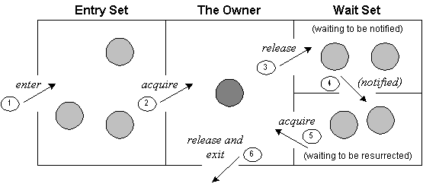
Understanding the process of inter-thread communication

Slide 43
Explanation
Threads enter to acquire lock.
Lock is acquired by on thread.
Now thread goes to waiting state if you call wait() method on the object. Otherwise it releases the lock and exits.
If you call notify() or notifyAll() method, thread moves to the notified state (runnable state).
Now thread is available to acquire lock.
After completion of the task, thread releases the lock and exits the monitor state of the object.

